Slide 1
A Place
in the Sky
Women in Aviation
and The Ninety-Nines
Heather Grimes
CFI Bootcamp
01
Notes:
SLIDE 1 | 0:00–0:10
Begin immediately with the story, before your biography. Welcome pilots at every level. CFI Bootcamp is the host, not the subject. Say: “Tonight starts with a race. It ends with the many routes a pilot can take today.”
IMAGE CREDIT
The Ninety-Nines community collage
Image supplied by Heather Grimes
Presenter-supplied 99s.jpg

Slide 2
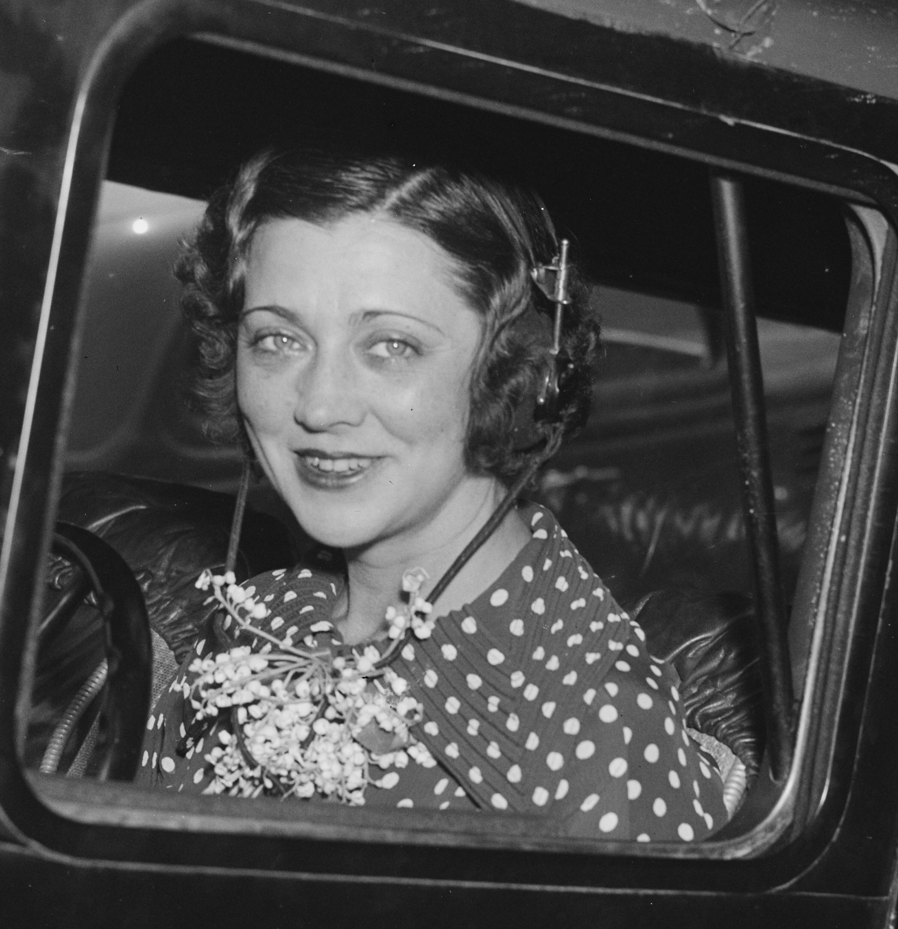
An Airplane
on Fire
Blanche Noyes / Women’s Air Derby / 1929
A forced landing in the desert
An extinguisher that would not work
Sand, bare hands, and a decision to continue
Blanche Noyes
02
Notes:
SLIDE 2 | 0:10–1:20
Story script: “You are racing across the country. Other pilots are trying to beat your time. Then your airplane catches fire. The race stops mattering. Getting on the ground matters. During the 1929 Women’s Air Derby, Blanche Noyes landed in the desert. Her extinguisher failed. She used sand and her bare hands to put out the fire. Noyes continued the race. Imagine the physical work of flying that airplane, handling the emergency, and then deciding what comes next. This was a contest involving real skill and real risk. Tonight, I want us to meet these women as pilots.” Do not invent dialogue, precise cockpit sensations, or a proven cause of the fire. Historical narrative, not emergency-procedure guidance.
SOURCES
derby: https://la99s.org/1929-air-derby/
derby2: https://www.ninety-nines.org/pdf/newsmagazine/20230506.pdf
IMAGE CREDIT
Blanche Noyes
Wikimedia Commons image record
https://commons.wikimedia.org/wiki/File:Blanche_Noyes.jpg
https://upload.wikimedia.org/wikipedia/commons/8/8b/Blanche_Noyes.jpg

Slide 3
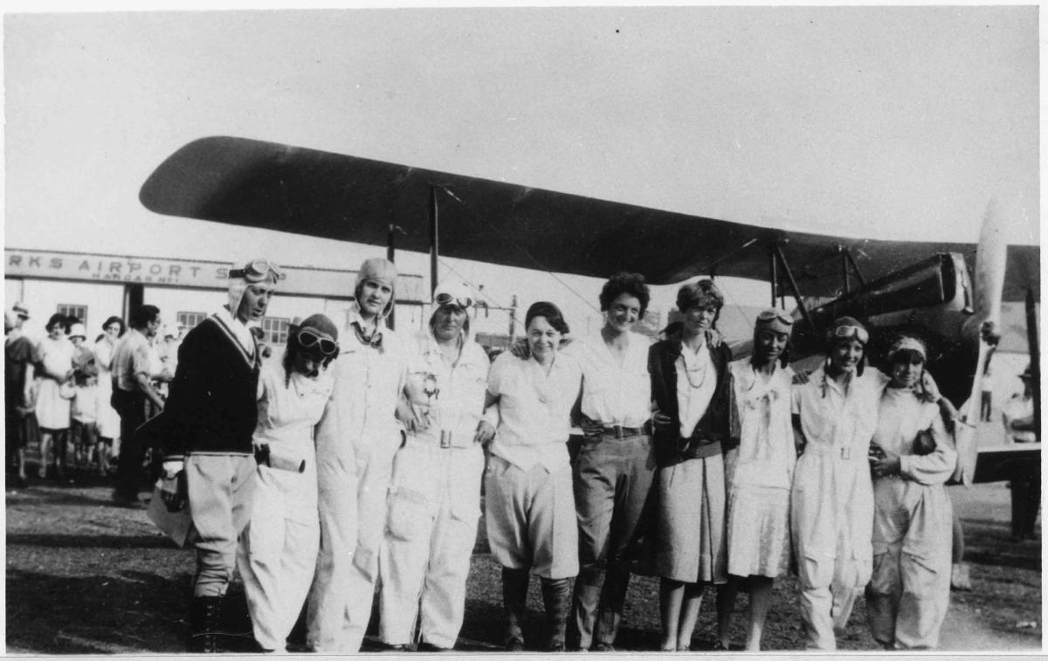
Competitors Who Stood Together
20 entrants
Santa Monica to Cleveland
A joint demand for a safer stop
Derby participants waiting for fog to lift in St. Louis, 1929
03
Notes:
SLIDE 3 | 1:20–2:10
Say: “The racers had another kind of decision to make. They considered the proposed Calexico stop unsuitable for the heavier aircraft. Together, they demanded a change. Organizers accepted a compromise allowing landing at Yuma, with identification over Calexico. They were competing against each other, yet willing to stand together over safety. What do you think matters most in that moment: competition, reputation, or collective judgment?” Invite 20 seconds of one-word chat answers. Do not describe sabotage allegations as established fact. Finisher counts differ by definition across sources; this deck uses entrants only.
SOURCES
derby: https://la99s.org/1929-air-derby/
founding: https://ninety-nines.org/history/
IMAGE CREDIT
Pilots at the 1929 Women’s National Air Derby
Photograph reproduced by National Endowment for the Humanities; see source page for original archival credit
https://www.neh.gov/article/1929-air-derby-helped-female-pilots-break-barriers
https://www.neh.gov/sites/default/files/styles/large/public/2023-03/2023_webimages_9a.jpg?itok=zDqxbx7Q

Slide 4
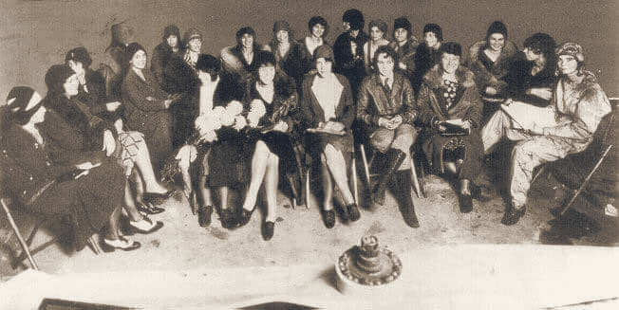
A Race Became a Community
November 2, 1929
Curtiss Field, Long Island
99 charter members gave the organization its name
First meeting of The Ninety-Nines, 1929
04
Notes:
SLIDE 4 | 2:10–3:00
Say: “The race brought these pilots together. In November 1929, women met at Curtiss Field to create The Ninety-Nines. The name came from its 99 charter members. The organization’s lasting contribution was a community that could support women after the race ended. Let’s turn to what women are doing with that community and opportunity today.” Source: The Ninety-Nines history. Distinguish the founding meeting from the total charter membership.
SOURCES
founding: https://ninety-nines.org/history/
IMAGE CREDIT
First meeting of The Ninety-Nines, 1929
The Ninety-Nines
https://ninety-nines.org/history/
https://ninety-nines.org/wp-content/uploads/2026/02/FirstMeeting_.png

Slide 5
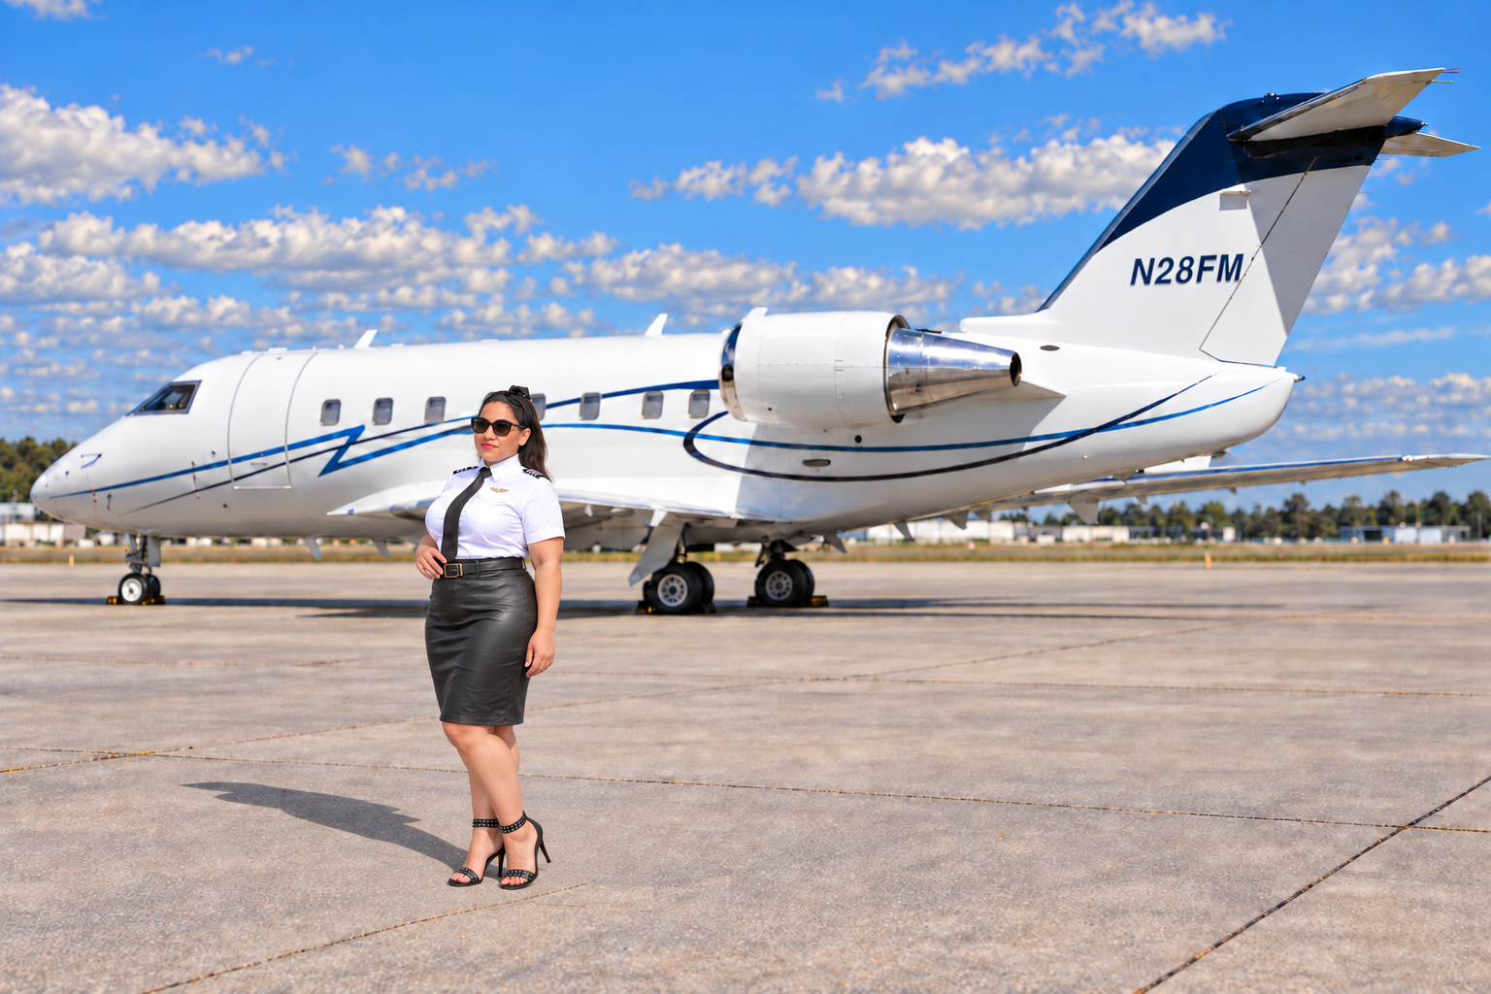
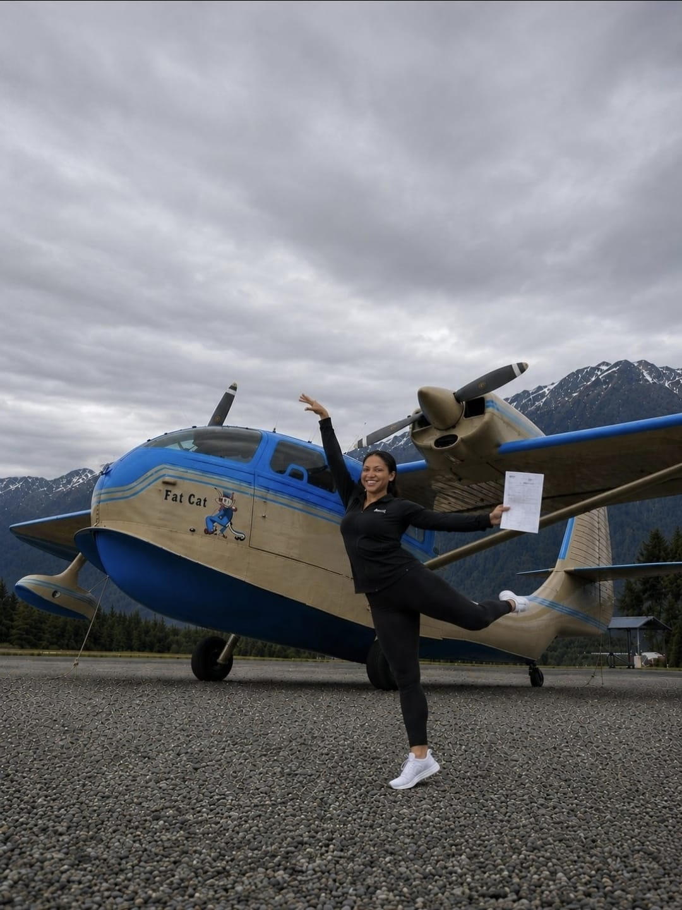
Heather Grimes
Director, International
Board of Directors
THE NINETY-NINES
ATP: Multiengine Land and Sea
A320 / E145 / CL601
CE500 / CE525
SUN ’n FUN, WAI, and Oshkosh Chair
Membership / Social Media
AEMSF Trust Board Liaison
Photos supplied by Heather Grimes
Assistant Director,
Miami ACE Academy
05
Notes:
SLIDE 5 | 3:00–4:30
Presenter-provided biography. Say: “I’m Heather Grimes, a Director on the International Board of Directors of The Ninety-Nines. I also serve as the organization’s SUN ’n FUN Chair, WAI Chair and Oshkosh Chair, with responsibilities for Membership and Social Media, and as liaison to the AEMSF Trust Board. I hold ATP multiengine land and sea ratings and type ratings in the A320, E145, CL601, CE500 and CE525. Tonight, I want to connect the women who helped establish our community with the opportunities pilots can explore today.” Expand WAI as Women in Aviation International and AEMSF as Amelia Earhart Memorial Scholarship Fund. Use the remaining minute for one true personal experience if desired. No employer, career sequence, flight hours, or personal anecdote has been supplied or invented. Heather also serves as Assistant Director for the Miami ACE Academy, as supplied by the presenter. IMAGE CREDIT: Additional presenter-supplied photograph, Seabee.jpeg, showing Heather beside an amphibious aircraft.
IMAGE CREDIT
Heather Grimes with Challenger N28FM
Presenter-supplied image
Provided by Heather Grimes

Slide 6
They Could Fly. Could They Get the Job?
The starting line
The airline cockpit
The training pipeline
06
Notes:
SLIDE 6 | 4:30–5:00
Say: “Winning a race, getting hired, and gaining access to advanced training were different challenges. We will look at one example of each.”

Slide 7
Louise Thaden and Blanche Noyes
1936 Bendix Trophy Race
Women could compete against men for the prize
They won
Louise Thaden after the 1929 Derby
07
Notes:
SLIDE 7 | 5:00–6:00
Say: “Louise Thaden, the heavy-aircraft class winner of the 1929 Derby, and Blanche Noyes competed together for the Bendix Trophy in 1936. In the first year women competed against men for that prize, they won. Changing who could enter changed who could win.” Pause and connect Noyes back to the opening. This photograph depicts Thaden after the 1929 Derby; do not label it as a two-person Bendix photograph.
SOURCES
thaden: https://airandspace.si.edu/explore/stories/air-racing
IMAGE CREDIT
Louise Thaden
Smithsonian National Air and Space Museum
https://airandspace.si.edu/multimedia-gallery/image/82-2132hjpg
https://airandspace.si.edu/sites/default/files/styles/slideshow_basic/public/images/82-2132h.jpg.webp?itok=EP4I25T-

Slide 8
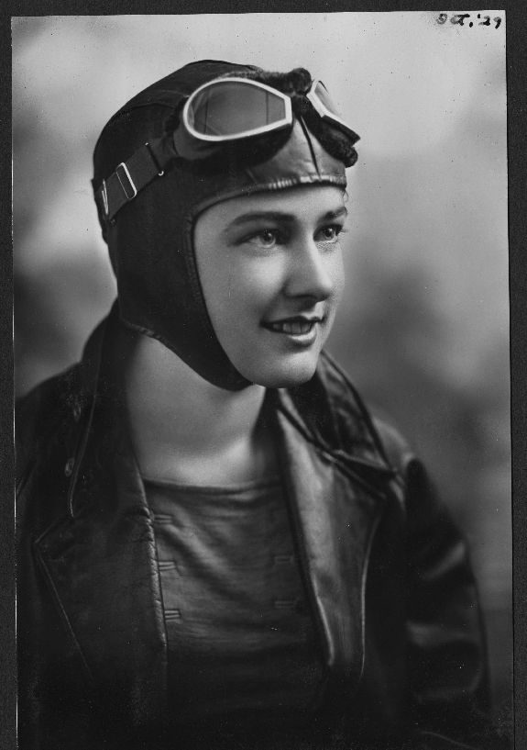
Helen Richey: Hired, Then Restricted
A scheduled airline position
Bad-weather restrictions
Union membership denied
Helen Richey, 1929
08
Notes:
SLIDE 8 | 6:00–7:00
Say: “Helen Richey became the first woman to pilot a commercial airliner on a regular scheduled run. But the Bureau of Air Commerce warned the airline to keep her grounded in bad weather, and the pilots’ union rejected her membership application. Getting through the hiring door did not give her equal working conditions. There were barriers inside the profession too.” Ask participants to think about how access differs from full participation.
SOURCES
richey: https://airandspace.si.edu/collection-archive/helen-richey-pilot-log-and-collection-suskalo/sova-nasm-1999-0006
IMAGE CREDIT
Helen Richey, 1929
San Diego Air and Space Museum Archives / Wikimedia Commons
https://commons.wikimedia.org/wiki/File:Helen_Richey_1929.jpg
https://upload.wikimedia.org/wikipedia/commons/4/41/Helen_Richey_1929.jpg?utm_source=commons.wikimedia.org&utm_campaign=index&utm_content=original

Slide 9
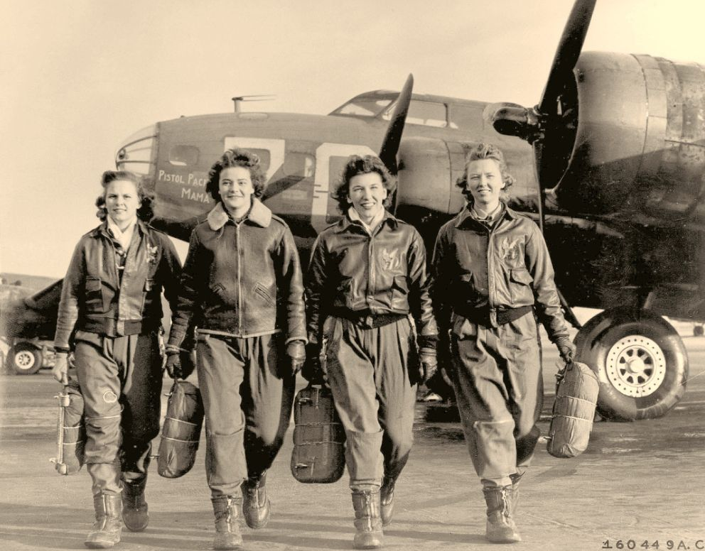
WASP: Military Flying, Civilian Status
Flying military aircraft
Serving as civilian pilots
Veteran status recognized in 1977
WASP pilots with a B-17
09
Notes:
SLIDE 9 | 7:00–8:00
Say: “The WASP flew military aircraft as civilians during World War II. Their flying duties and institutional status were different questions. They did not receive veteran recognition during their wartime service. After years of advocacy, legislation in 1977 granted veteran status. This is a concrete example of recognition arriving long after women had done the work.” Sources: National Museum of the U.S. Air Force. Keep this slide to about one minute in the fast-delivery schedule.
SOURCES
wasp: https://www.nationalmuseum.af.mil/Visit/Museum-Exhibits/Fact-Sheets/Display/Article/4064588/breaking-ground-women-air-force-service-pilots/
waspRecognition: https://www.nationalmuseum.af.mil/Visit/Museum-Exhibits/Fact-Sheets/Display/Article/4060228/disbandment-overdue-recognition/
IMAGE CREDIT
WASP pilots with a B-17
San Diego Air and Space Museum Archives / Wikimedia Commons
https://commons.wikimedia.org/wiki/File:Women_in_Aviation_Image_WW_II_WASP_80343006_-_Flickr_-_San_Diego_Air_%5E_Space_Museum_Archives.jpg
https://upload.wikimedia.org/wikipedia/commons/c/c8/Women_in_Aviation_Image_WW_II_WASP_80343006_-_Flickr_-_San_Diego_Air_%5E_Space_Museum_Archives.jpg?utm_source=commons.wikimedia.org&utm_campaign=index&utm_content=original

Slide 10

Jerrie Cobb and a Closed Training Route
Military jet test-pilot experience required
Women excluded from that military pathway
Medical test performance could not remove the barrier
Jerrie Cobb in the gimbal rig, 1960
10
Notes:
SLIDE 10 | 8:00–9:00
Say: “NASA’s early astronaut criteria included military jet test-pilot training. Women did not have access to that military route. Lovelace’s privately organized testing explored women’s suitability, but success there did not satisfy the selection requirements. Jerrie Cobb’s individual gimbal-rig testing at NASA is shown here. It does not mean the Mercury 13 constituted a NASA astronaut-training group.”
SOURCES
mercury: https://www.nasa.gov/wp-content/uploads/2023/02/NACA-to-NASA-to-NOW_TAGGED.pdf
cobb: https://www.nasa.gov/centers-and-facilities/glenn/aviator-jerrie-cobb-trained-in-nasas-gimbal-rig-in-1960/
IMAGE CREDIT
Jerrie Cobb in the MASTIF gimbal rig, 1960
NASA
https://www.nasa.gov/centers-and-facilities/glenn/aviator-jerrie-cobb-trained-in-nasas-gimbal-rig-in-1960/
https://www.nasa.gov/wp-content/uploads/2023/06/grc-1960-c-53087-0.jpg?w=1200

Slide 11
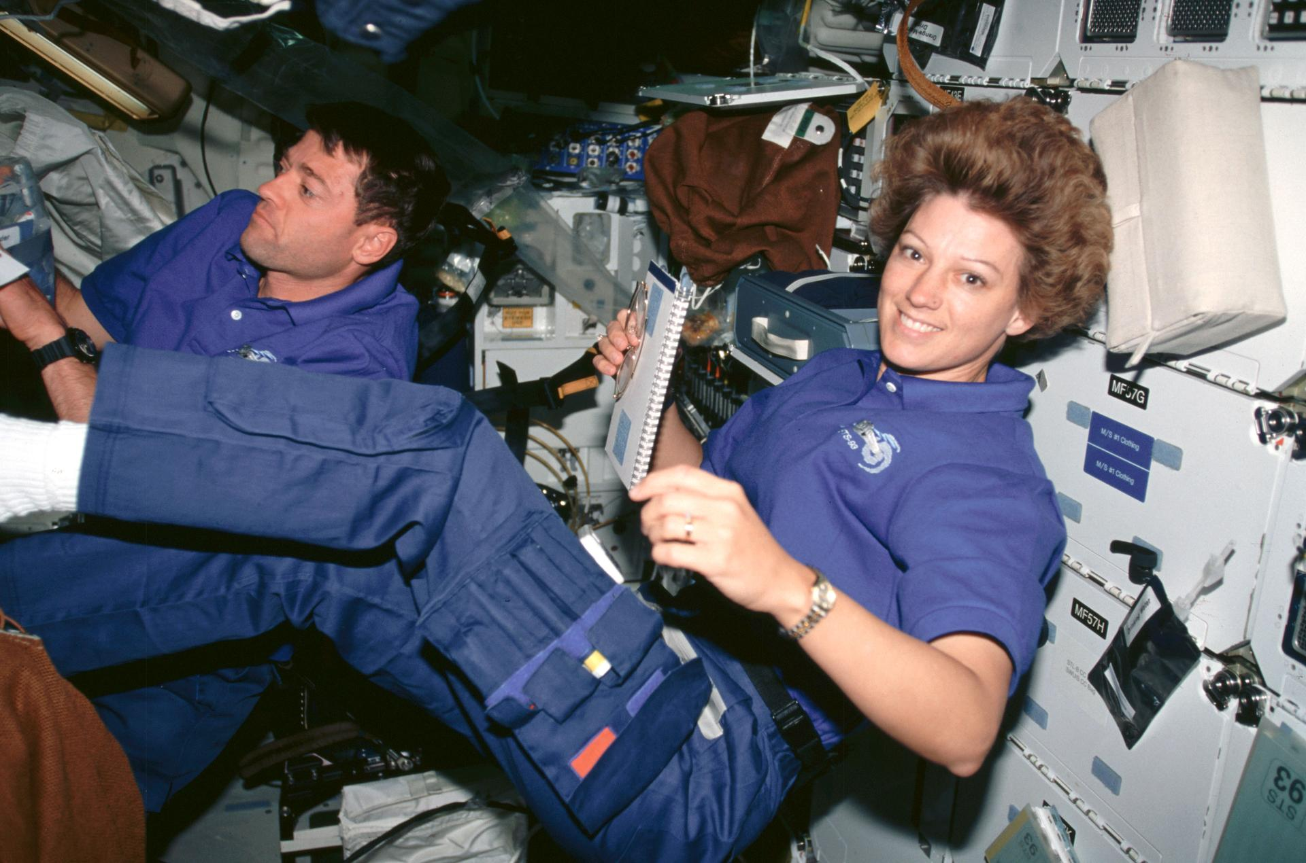
Eileen Collins: The Commander’s Seat
Shuttle pilot in 1995
Commander of STS-93 in 1999
A launch honoring women aviation pioneers
Eileen Collins and Jeffrey Ashby, STS-93
11
Notes:
SLIDE 11 | 9:00–10:00
Say: “Eileen Collins served as Shuttle pilot in 1995, then commanded Columbia in 1999. NASA dedicated the historic launch to women aviation pioneers, including The Ninety-Nines and the WASP.” Chat: “Score out of three, plus your biggest surprise.” Read one response. Transition: “We have seen where opportunities were blocked and where they expanded. What support would you fund today?”
SOURCES
collins: https://www.nasa.gov/humans-in-space/astronauts/former-astronauts/eileen-m-collins/eileen-collins-broke-barriers-as-americas-first-female-space-shuttle-commander/
IMAGE CREDIT
Eileen Collins and Jeffrey Ashby reviewing checklists on STS-93
NASA
https://www.nasa.gov/humans-in-space/astronauts/former-astronauts/eileen-m-collins/eileen-collins-broke-barriers-as-americas-first-female-space-shuttle-commander/
https://images-assets.nasa.gov/image/sts093-309-027/sts093-309-027~large.jpg?w=1400

Slide 12
Women Making a Difference Today
Flying research missions
Building aviation businesses
Creating access for the next pilot
12
Notes:
SLIDE 12 | 10:00–10:30
Say: “Women influence aviation through the work they do and the opportunities they create for others. We will meet four contemporary examples. These are examples of impact, rather than a ranking or a complete list.” Invite the audience to keep an additional name in mind for the chat.

Slide 13
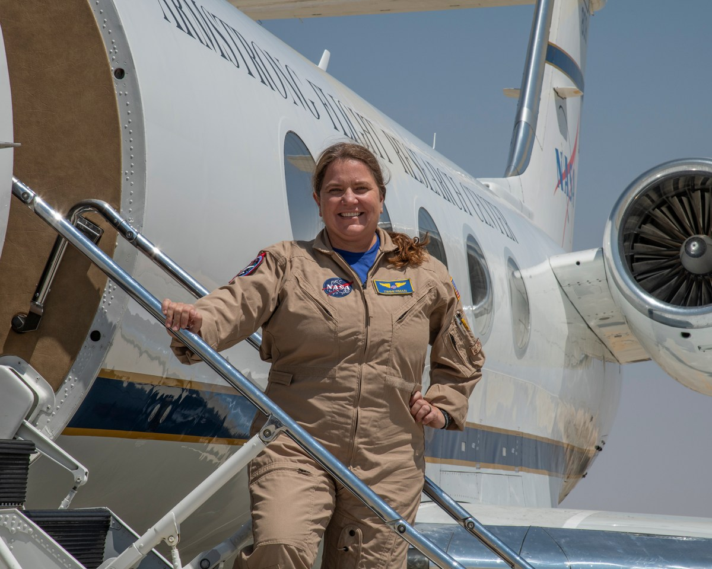
Carrie Worth: Flying for Research
NASA research pilot
Gulfstream G-III mission support
Operational experience supporting science
Carrie Worth, NASA research pilot
13
Notes:
SLIDE 13 | 10:30–11:15
NASA’s current biography identifies Carrie Worth as an Armstrong research pilot who joined its flight operations staff in 2021 and flies the Gulfstream G-III mission support aircraft. Say: “Her role shows a kind of professional flying that people may overlook: supporting research and science missions. Operational flying experience can contribute to work beyond passenger transport.” Do not identify her as an astronaut or claim she is the X-59 pilot. Ask: “Who here has considered research or mission-support flying?” Use reactions, not a microphone queue.
SOURCES
worth: https://www.nasa.gov/people/carrie-l-worth/
IMAGE CREDIT
Carrie Worth, NASA research pilot
NASA
https://www.nasa.gov/people/carrie-l-worth/
https://www.nasa.gov/wp-content/uploads/2021/03/afrc2021-0108-052.jpg?w=1200

Slide 14
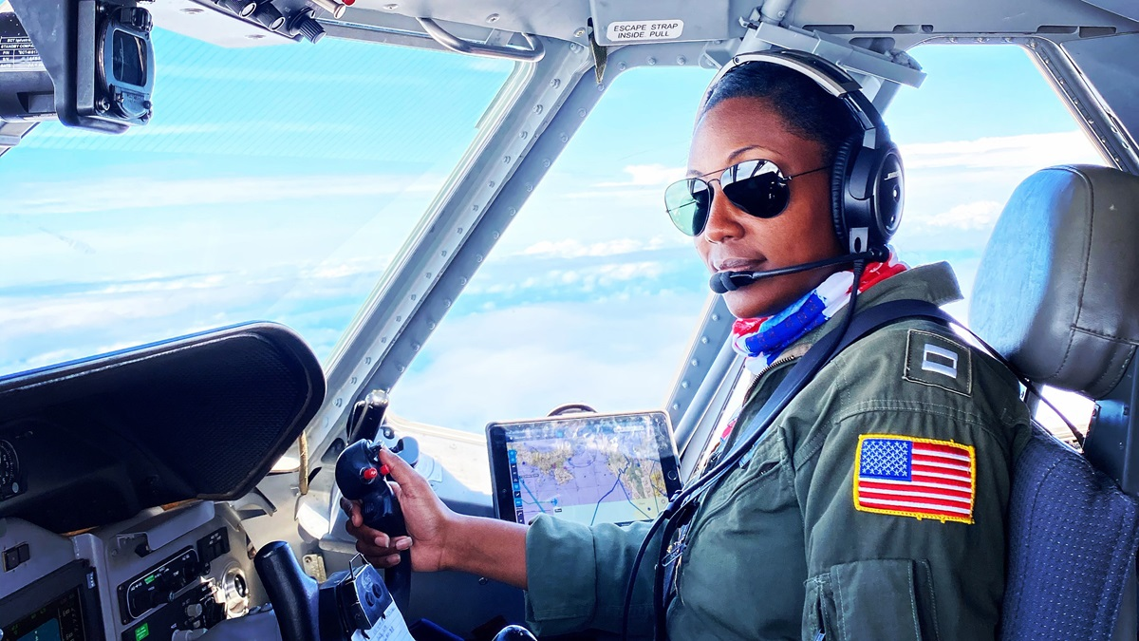
Angel Hughes: A Community That Opens Doors
Co-founder of Sisters of the Skies
Mentorship and scholarships
Outreach for future women pilots of color
Christine Angel Hughes, Sisters of the Skies co-founder
14
Notes:
SLIDE 14 | 11:15–12:00
Christine Angel Hughes is identified as a founder by AOPA, and the organization’s own story identifies Angel Hughes among its founding women. Say: “Sisters of the Skies connects women of color pilots and supports future aviators through mentoring, scholarships and outreach. It creates access to people who understand the route, as well as practical resources.” The photograph comes from a 2020 profile, not a claim about her current uniform or employer. Do not repeat unsupported or outdated population counts. The current program information comes from the organization’s website.
SOURCES
hughes: https://sistersoftheskies.org/our-story/
sisters: https://sistersoftheskies.org/
IMAGE CREDIT
Christine Angel Hughes
Photo courtesy of Lt. Christine Hughes, U.S. Coast Guard, reproduced by AOPA
https://www.aopa.org/news-and-media/all-news/2020/september/10/meet-sisters-of-the-skies-founder-lt-christine-angel-hughes
https://www.aopa.org/-/media/Images/AOPA-Main/News-and-Media/2020/September/0910_sister_of_skies.jpg?mw=1200&mh=675&as=1&hash=E3CFE3D1A402B1B44B426B051C12054D

Slide 15
Christine Kelley: F-35 Pilot and Instructor
First woman to fly the F-35 in 2015
F-15E and F-35A experience
Simulator and academic instruction for F-35A pilots
Lt. Col. (Ret.) Christine “Grinder” Kelley
15
Notes:
SLIDE 15 | 12:00–12:45
Say: “Christine ‘Grinder’ Kelley is a retired U.S. Air Force lieutenant colonel and became the first woman to fly the F-35 in 2015. Her experience includes the F-15E and F-35A, instructor and evaluator work, and squadron and group leadership. Her published biography describes her continuing contribution as a contract instructor at Eglin, teaching simulator sessions and academics to F-35A pilots. This is an example of operational experience benefiting the pilots who follow. Her biography also identifies her as a member of The Ninety-Nines.” Retired military status and the current instructional role are separate. Sources: the 2025 Embry-Riddle panel biography and the published NWFMOA biography. Keep this profile to about 45 seconds in the fast-delivery schedule.
SOURCES
kelley: https://erauathletics.com/sports/2025/8/23/christine-kelly-hh.aspx?path=marketpro
kelleyBio: https://nwfmoa.org/files/kelley.pdf
IMAGE CREDIT
Lt. Col. (Ret.) Christine “Grinder” Kelley
Embry-Riddle Aeronautical University Athletics, 2025 Hoops & Heels biography
https://erauathletics.com/sports/2025/8/23/christine-kelly-hh.aspx?path=marketpro
https://erauathletics.com/images/2025/8/23/Kelly.png

Slide 16
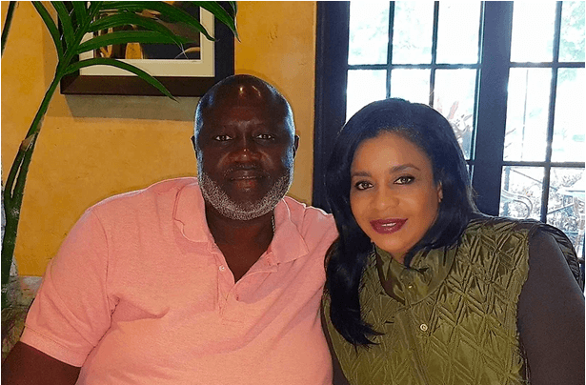

Western Air: Ownership and Leadership
Shandrice Woodside-Rolle
Co-founder and COO
Sherrexcia “Rexy” Rolle
President and CEO
Founders: Captain Rex Rolle and Shandrice Woodside-Rolle
Black family-owned airline in The Bahamas
Sherrexcia “Rexy” Rolle, President and CEO
16
Notes:
SLIDE 16 | 12:45–14:15
Say: “Women’s place in aviation includes airline ownership and executive leadership. Shandrice Woodside-Rolle co-founded Western Air with Captain Rex Rolle in 2000. The airline’s own history says her idea came from recognizing limited service after a visit to her hometown. Their daughter, Sherrexcia, known as Rexy Rolle, is now President, CEO and General Counsel. Her background includes aviation and corporate law. This is a family-owned Bahamian airline with women central to both its creation and continued leadership.” Distinguish Shandrice’s co-founder role from Rexy’s current executive role. The available sources do not establish a sole owner or a globally exclusive Black female airline-owner claim. Avoid that superlative. Both photographs are from Western Air or its company press release.
SOURCES
western: https://www.westernairbahamas.com/our-airline/
westernRelease: https://www.prnewswire.com/news-releases/western-air-appoints-first-woman-president--ceo-sherrexcia-rexy-rolle-appoints-rex-rolle-as-chairman-302025305.html
IMAGE CREDIT
Captain Rex Rolle and Shandrice Woodside-Rolle, Western Air founders
Western Air
https://www.westernairbahamas.com/our-airline/
https://www.westernairbahamas.com/wp-content/uploads/2022/11/Captain-Rex-Rolle-Shandrice-Woodside-Rolle-1.png

Slide 17
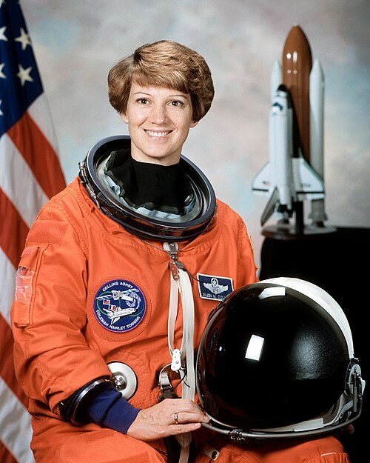
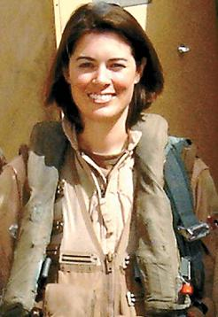
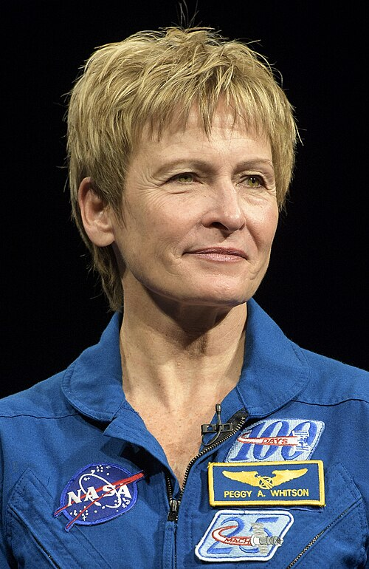
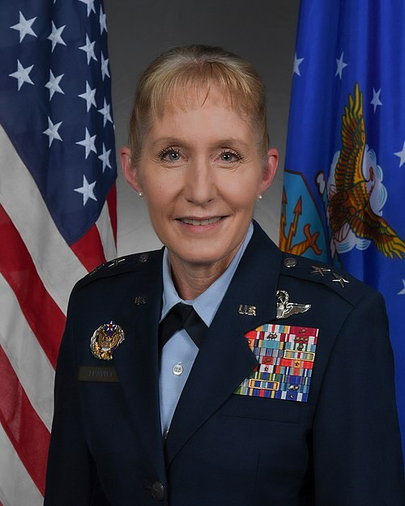
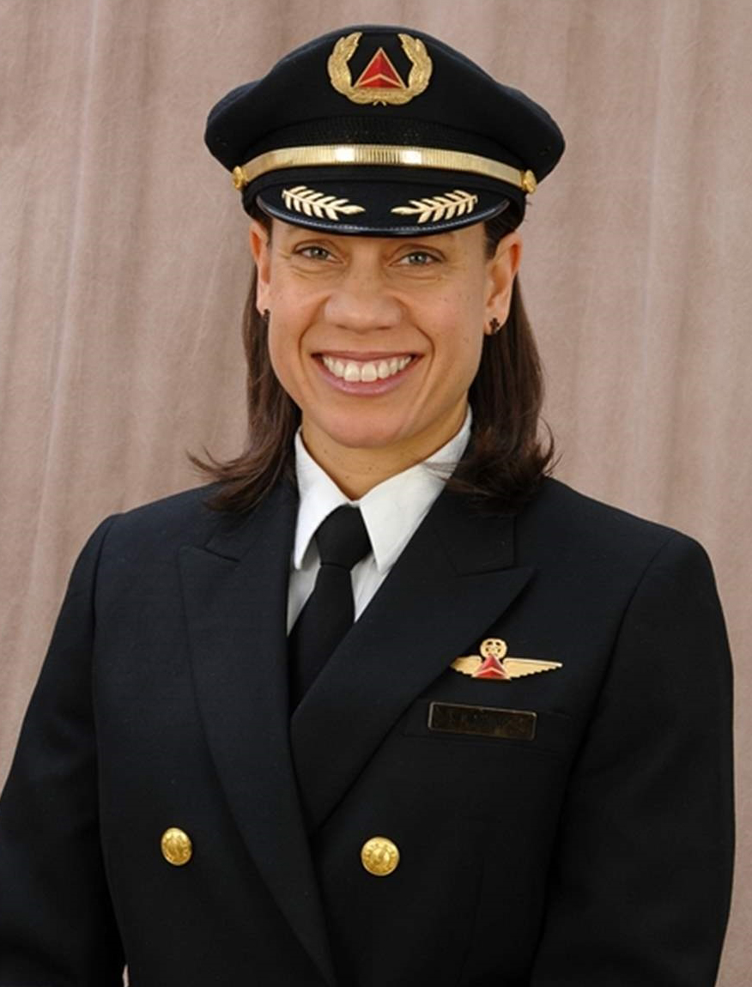
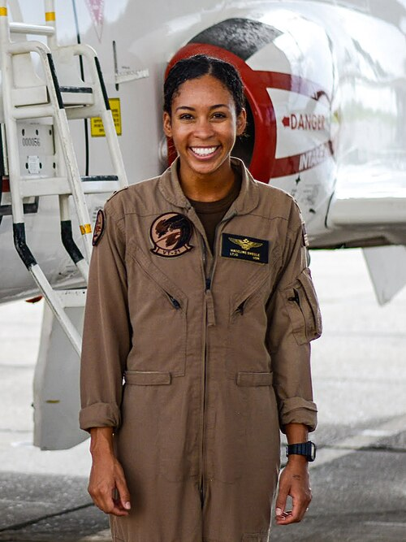
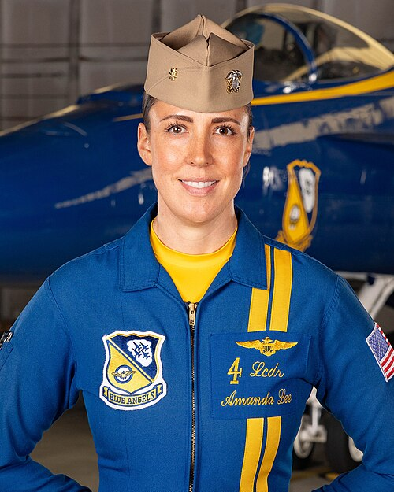
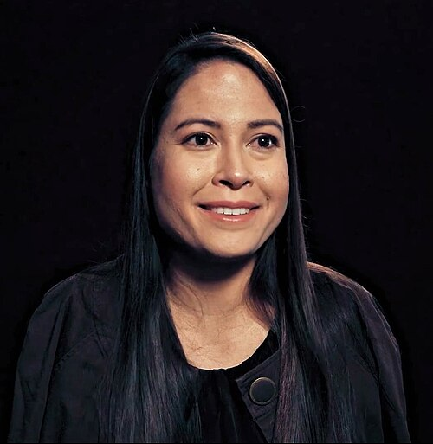
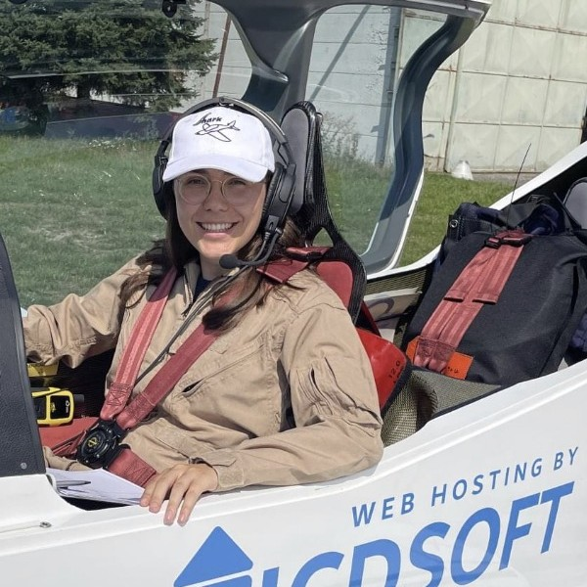
Ten Recent Aviation Firsts
Eileen Collins
Nicole Malachowski
Peggy Whitson
Jeannie Leavitt
Stephanie Johnson
1999 · First woman
Space Shuttle commander
2005 selection · First
woman Thunderbirds pilot
2007 · First woman
ISS commander
2012 · First woman to
lead a USAF fighter wing
2016 · Delta’s first
Black woman captain
Madeline Swegle
Amanda Lee
Joanna Geraghty
Jessica Cox
Zara Rutherford
2020 · First Black woman
USN tactical jet pilot
2022 selection · First
woman Blue Angels jet pilot
2024 · First woman CEO
of a major U.S. airline
2008 · First certificated
pilot without arms
2022 · First woman
around the world solo
in a microlight
17
Notes:
SLIDE 17 | 14:15–16:00
Eight firsts from the last 30 years: Eileen Collins commanded a Space Shuttle mission in 1999. Nicole Malachowski was selected for the Thunderbirds in 2005 and flew the 2006 season. Peggy Whitson became the first woman ISS commander in 2007. Jeannie Leavitt became the first woman to command a USAF fighter wing in 2012; her earlier fighter-pilot first falls outside this slide’s time window. Stephanie Johnson became Delta’s first Black woman captain in 2016. Madeline Swegle became the U.S. Navy’s first-known Black woman tactical jet aviator in 2020. Her milestone concerns tactical jet aviation, not the first Black woman naval aviator in any aircraft. Amanda Lee was selected as the Blue Angels’ first woman F/A-18 demonstration pilot in 2022, for the 2023 show season. Joanna Geraghty became the first woman CEO of a major U.S. airline in 2024. Define the scope of each first accurately: Delta-specific captaincy, USAF fighter-wing command, and Blue Angels jet demonstration flying. All dates are within 30 years of October 9, 2026. The two selection dates are distinct from first demonstration seasons. Keep the captions brief and spend approximately 75 seconds on the slide. Jessica Cox became the first person without arms to earn a pilot certificate in 2008, flying an Ercoupe with her feet. Zara Rutherford completed the first solo circumnavigation by a woman in a microlight on January 20, 2022. Her separate youngest-woman record is not the first solo circumnavigation by any woman. Connect these general aviation achievements to adapting training and building support. Allow approximately two minutes for the ten portraits.
SOURCES
collinsFirst: https://www.nasa.gov/history/eileen-collins-nasas-first-female-shuttle-commander/
malachowski: https://www.af.mil/News/Article-Display/Article/134029/becoming-thunderbird-is-dream-come-true-for-nevada-native/
whitson: https://www.nasa.gov/image-article/first-female-iss-commander/
leavitt: https://www.af.mil/News/Photos/igphoto/2000146477/mediaid/12676/
johnson: https://news.delta.com/sites/default/files/Delta_2016_CSR_0.pdf
johnsonYear: https://www.wabe.org/deltas-first-black-female-pilot-reflects-on-international-womens-day/
lee: https://www.navy.mil/DesktopModules/ArticleCS/Print.aspx?Article=3345807&ModuleId=2652&PortalId=1
geraghty: https://news.jetblue.com/latest-news/press-release-details/2024/JetBlue-Announces-CEO-Succession/default.aspx
geraghtyFirst: https://www.forbes.com/sites/kimelsesser/2024/01/09/jetblue-will-be-the-first-major-us-airline-with-a-female-ceo/
swegle: https://www.navy.mil/Resources/Photo-Gallery/igphoto/2002467437/
swegleBio: https://www.navy.mil/DesktopModules/ArticleCS/Print.aspx?Article=2959945&ModuleId=2652&PortalId=1
cox: https://www.aopa.org/news-and-media/all-news/2013/february/12/armless-pilot-jessica-cox-to-be-focus-of-documentary
zara: https://news.stanford.edu/stories/2023/02/zara-rutherfords-flight-plan

Slide 18
Which Contribution Opens the Most Doors?
Where would you invest your effort?
A Operational expertise and safety
B Building a supportive workplace
C Scholarships and outreach
D Mentoring and professional connections
POLL P1 Choose one answer
18
Notes:
SLIDE 18 | 16:00–17:15
Launch P1. This is a discussion poll, not a factual quiz. Give 20 seconds. Say: “There is no single right answer. These examples show several kinds of influence.” After results, ask the audience to name another woman making a difference and write her contribution in five words. Read two responses. Do not infer the audience’s demographic makeup from the results.

Slide 19
A Training Problem Needs a Specific Plan
Cost: a funded next milestone
Progress: a clear standard and debrief
Continuity: a written training record
Support: one person who knows your goals
19
Notes:
SLIDE 19 | 17:15–18:00
Say: “When someone says training is not working, the next question is what is breaking down. A budget gap, repeated cancellations, an instructor change, and a skill plateau need different responses.” Practical suggestions: estimate the actual cost to the next rating or milestone with a reserve for delays; agree on a realistic lesson cadence; ask what performance standard is not yet met; keep a written progress record so a new instructor can pick up where training stopped. Schools should provide clear expectations and accountable instruction. These actions are not a guarantee of success and do not make the student responsible for an unsupportive school.
SOURCES
school: https://www.faa.gov/licenses_certificates/airline_certification/pilotschools
barriers: https://www.faa.gov/regulations_policies/rulemaking/committees/documents/media/WIAAB_Recommendations_Report_March_2022.pdf

Slide 20
Scenario: The Budget Is Running Out
What would you do first?
A Buy a large prepaid block of lessons
B Review progress, scheduling, and cost to the next milestone
C Wait until motivation returns
D Abandon the career goal
POLL P2 Choose one answer
20
Notes:
SLIDE 20 | 18:00–19:00
FICTIONAL SCENARIO. A pilot has had repeated lesson cancellations and has nearly exhausted the budget. Ask the audience to choose the first useful next step. P2 is a discussion decision with a preferred starting point B. Give 25 seconds. After the vote, explain that the decision requires reliable cost and progress information before more spending. A scholarship search can accompany that review, but is not a guaranteed rescue. Move to slide 21.

Slide 21
A Conversation That Protects Your Progress
“What standard am I missing?”
“What will the next three lessons address?”
“Can we review the cost and schedule?”
21
Notes:
SLIDE 21 | 19:00–20:00
Presenter-created sample wording. Say: “A useful conversation produces something you can act on. Ask which standard is missing, which tasks the next lessons will address, and how you will know you are progressing. Review why cancellations occurred and what availability is realistic. If the school cannot provide a workable plan, compare alternatives and discuss how records or training credit transfer before changing providers. Do not assume all hours or Part 141 course credit will transfer unchanged.” Suggest preparing a concise progress summary and asking for copies of records. The school and instructor also carry responsibility for delivering appropriate instruction.

Slide 22
A Plateau Is a Planning Signal
One task at a time
Specific feedback after each lesson
A planned progress review
A second instructional perspective when needed
22
Notes:
SLIDE 22 | 20:00–21:00
Say: “Replace ‘I am bad at flying’ with a description of the task that needs work. After a lesson, record what worked, the specific error and the next practice task. Agree on a review point rather than repeating the same lesson indefinitely. A stage check or another instructor’s perspective may help identify the issue.” Ask for a task-specific practice plan and ensure procedural rehearsal matches approved procedures and instructor guidance. Do not compare your timeline to someone else’s highlight reel. This section concerns practical training management, with no sex-based learning claims.

Slide 23
Money, Scheduling, and a Life Outside Flying
A scholarship application calendar
Lessons that match real availability
A reserve for delays and retests
A plan for pauses and re-entry
23
Notes:
SLIDE 23 | 21:00–22:00
Say: “Use a calendar of scholarships whose eligibility fits you. Prepare your aviation goal, training estimate, references and documentation before deadlines. Confirm which costs an award covers. Schedule lessons against actual aircraft and instructor availability, and ask how the school handles continuity if an instructor leaves. If work or family means a pause, plan the next step and recurrency requirements before restarting.” Do not imply that family or caregiving is exclusive to women. Discuss childcare or scheduling needs only as circumstances participants may choose to raise. Avoid promises about award dates or individual medical eligibility.
SOURCES
scholarships: https://ninety-nines.org/scholarships/
wai: https://www.wai.org/scholarships
barriers: https://www.faa.gov/regulations_policies/rulemaking/committees/documents/media/WIAAB_Recommendations_Report_March_2022.pdf

Slide 24
Workplace Barriers Need More Than Confidence
Clear criteria for hiring and advancement
Access to useful experience
A mentor and someone who can sponsor you
A channel for concerns that works
24
Notes:
SLIDE 24 | 22:00–23:00
Say: “The burden of changing a workplace does not belong entirely to the person facing the barrier. Employers should set clear criteria, distribute opportunities fairly and respond to concerns. An individual can ask which qualifications or experiences matter, keep a record of relevant work, and seek advice or an introduction from a trusted person.” Distinguish mentoring (advice) from sponsorship (someone advocating for an opportunity). These are practical frameworks, not guaranteed routes to promotion.
SOURCES
barriers: https://www.faa.gov/regulations_policies/rulemaking/committees/documents/media/WIAAB_Recommendations_Report_March_2022.pdf
nbaa: https://nbaa.org/news/business-aviation-insider/2023-09/looking-at-pilot-hiring-through-a-new-lens/

Slide 25
Scenario: Qualified, but Overlooked
Which information would help most?
A The written selection criteria
B The experience gap, with a way to close it
C A documented explanation of the decision
D All of these, depending on the situation
POLL P3 Choose one answer
25
Notes:
SLIDE 25 | 23:00–24:00
FICTIONAL SCENARIO. A qualified pilot repeatedly misses selection for developmental assignments and receives vague feedback. P3 asks what information would make a next step possible; there is no single correct answer, because the circumstances differ. Give 25 seconds. Invite one short chat response stating a question the pilot could ask. Transition to the concrete wording on slide 26.

Slide 26
Questions That Turn Vague Feedback into Action
“Which criterion did I not meet?”
“What experience would make me competitive?”
“How are these assignments selected?”
“When can we review my progress?”
26
Notes:
SLIDE 26 | 24:00–25:00
Presenter-created wording. Say: “Keep the discussion tied to work and criteria. Ask for a specific gap, a chance to gain relevant experience and a review point. Follow up with a brief factual email so the next step is clear.” If there is a pattern of bias, harassment or exclusion, record dates, exact conduct, relevant witnesses and work or safety effects; seek trusted support and use the school or employer’s published reporting channels. Choose a route appropriate to the circumstances rather than confronting alone. Safety concerns should follow the operation’s established reporting procedures. Do not offer individualized legal advice or imply that documenting guarantees an outcome.
SOURCES
barriers: https://www.faa.gov/regulations_policies/rulemaking/committees/documents/media/WIAAB_Recommendations_Report_March_2022.pdf

Slide 27
Many Routes to the Flight Deck
Airline and corporate flying
TRAINING
QUALIFICATIONS
EXPERIENCE
DESTINATIONS
Local school
Part 61
Instruction, survey,
tour or other
qualified flying
Airline flying
Regional or direct hire
Academy / school
Part 141
Appropriate
certificates, ratings
and experience
Charter, cargo or
business aviation
when qualified
Eligible university
aviation program
Corporate / business
flight deck
Military operational
flying and civilian
transition
Military flight
training
Illustrative U.S. routes. Eligibility and hiring vary. Pilots can move between sectors.
27
Notes:
SLIDE 27 | 25:00–26:30
This editable diagram shows illustrative U.S. airplane career routes, not guaranteed sequences. Local Part 61, structured Part 141/academy, eligible university programs, and military training feed different experience routes. Instruction is one option, not a mandatory career step. Survey, tour, ferry, cargo, charter and business flying each have their own qualifications; availability and legal flight-time logging matter. Military service carries selection requirements and service obligations. Some pilots enter corporate flying directly when qualified; others arrive from charter or airlines. Regional employment is common but not required for every airline hire. Pilots may move between sectors. All destinations require appropriate credentials and employer/operator requirements. A class date, upgrade, or hiring offer is never implied by a connector.
SOURCES
faa: https://www.faa.gov/pilots/training/atp
school: https://www.faa.gov/licenses_certificates/airline_certification/pilotschools
internship: https://nbaa.org/wp-content/uploads/flight-department-administration/internships/NBAA21_Internship_Career_Guide.pdf

Slide 28
You Have 100 Aviation Dollars
A fictional chapter. A real decision about priorities.
A Flight-training scholarships
B Mentorship and career connections
C Introductory aviation experiences
D Flying activities and pilot community
Split $100 / A50 B20 C20 D10 / Hold, then send
28
Notes:
SLIDE 28 | 26:30–28:00
Fictional resource-allocation activity. Your chapter has $100 to support women’s progress. A scholarships; B mentorship and career connections; C introductory aviation experiences; D flying activities and pilot community. Give 30 seconds to write an allocation totaling $100, but hold it. Say SEND. Read two different allocations and one sentence of reasoning each. Select examples without claiming a representative average. Ask: “Which obstacle are you trying to remove with that investment?”

Slide 29
New Information Changes the Decision
Introductory flights already have strong funding
Pilots pursuing advanced ratings lack mentors and connections
Would you change your allocation?
A Yes, substantially
B Yes, slightly
C No
D I need more information
POLL P4 Choose one answer
29
Notes:
SLIDE 29 | 28:00–29:00
FICTIONAL UPDATE. Introductory flights already have strong funding, while pilots pursuing advanced ratings lack mentors and connections. Launch P4 for 20 seconds. There is no right answer. Invite a revised allocation in chat. Read one example. Debrief: “Support works best when it addresses the actual need, and that need changes as a pilot progresses.”

Slide 30
The Ninety-Nines Today
Student pilots welcome
Scholarships
Chapter connections
PPLI mentoring
Education and aviation history
The Ninety-Nines community
30
Notes:
SLIDE 30 | 29:00–30:00
Say: “The Ninety-Nines provides a place to ask for connections, explore scholarship eligibility and find people at different stages of flying. Student pilots can join. Chapter activities vary, and PPLI offers structured mentoring and leadership development for qualified members. Ask your chapter what is available and which next step it can help you take.” Connect your own board, membership and scholarship liaison work to facilitating access. Do not invent a personal scholarship story or guarantee a mentor match.
SOURCES
about: https://ninety-nines.org/about-us/
scholarships: https://ninety-nines.org/scholarships/
ppli: https://www.ninety-nines.org/userfiles/file/PPLI/PPLIFactSheet2023.pdf
IMAGE CREDIT
The Ninety-Nines community collage
Image supplied by Heather Grimes
Presenter-supplied 99s.jpg

Slide 31
The Mentor Request That Is Easy to Answer
Which first request is more actionable?
A “Please help me with my entire aviation career.”
B “Could we spend 15 minutes reviewing my instrument-training plan?”
POLL P5 Choose one answer
31
Notes:
SLIDE 31 | 30:00–31:00
Launch P5 for 20 seconds. Preferred starting point B because it identifies a specific need and a bounded request. A broad career conversation can still be useful; the point is to make the first contact actionable. Ask people to write their own two-sentence request in chat, hold then send. Read one example. No microphone queue.

Slide 32
A Connection Can Become an Opportunity
A mentor helps you make a plan
A sponsor can advocate for your work
A peer can share information and accountability
32
Notes:
SLIDE 32 | 31:00–32:00
Say: “Build several kinds of relationships. Ask a mentor a concrete question. Let someone who knows your work know which role or assignment interests you. Stay in touch with peers who can share accurate openings and training information. When requesting an introduction, provide a concise background and what you hope to learn. Follow through and update the person who helped.” Do not imply that sponsorship replaces qualifications or that knowing someone ensures selection. A network should create access to information and consideration, with fair evaluation.

Slide 33
Pathways as a Hiring Option
A possible hiring route alongside other career choices
One possible route to an employer
Structured milestones and mentoring
Qualifications and selection still matter
33
Notes:
SLIDE 33 | 32:00–32:30
Say: “Some employers offer pathway or cadet arrangements. These can connect training and experience with a possible hiring opportunity. They are one route among many. A pathway can offer milestones or mentoring, while certificates, performance and selection requirements remain important. Look at the written terms and choose what fits your goals.” Keep this to about 45 seconds, without naming or comparing airline programs. Use the remaining time for the career-route discussion. This is general career guidance, not a guarantee of hiring.
SOURCES
faa: https://www.faa.gov/pilots/training/atp
internship: https://nbaa.org/wp-content/uploads/flight-department-administration/internships/NBAA21_Internship_Career_Guide.pdf

Slide 34
An Interview Answer Worth Hearing
“Tell me about a time you made a mistake.”
A specific situation
Your decision and actions
The result
What you learned or changed
34
Notes:
SLIDE 34 | 32:30–34:00
Presenter-created interview coaching. Say: “Prepare true examples about judgment, teamwork, mistakes and receiving feedback. Describe your own actions and what changed afterward. Reconcile your logbook, application and records. Research the operation and explain why its flying fits your goals. For corporate roles, prepare to discuss discretion, service, teamwork, flexibility and safety under schedule pressure. For airline roles, prepare for standardized procedures, crew coordination and technical evaluation. Use a mock interview and review how clearly you answer. Do not memorize an invented story.” For virtual interviews: quiet setting, tested audio/video, professional framing, current documents. Ask employers about training, schedules and safety practices. Ask each person to privately note one true example of handling an error or receiving feedback. They do not need to disclose sensitive personal details to the audience.
SOURCES
nbaa: https://nbaa.org/news/business-aviation-insider/2023-09/looking-at-pilot-hiring-through-a-new-lens/
interview: https://www.aopa.org/news-and-media/all-news/2021/may/17/tips-to-prepare-virtually-for-your-online-pilot-interview

Slide 35
Your Next Chapter
One next step for your own flying
One connection you can offer another pilot
35
Notes:
SLIDE 35 | 34:00–35:00
Chat commitment: “One obstacle, one next action, and one person or resource that can help. Write, hold, then SEND.” Close the live content by linking the community formed in 1929 to women creating access today. Say: “Your next action can be small and specific. Your school, employer and community also have a role in making progress possible.”

Slide 36
Questions and Discoveries
What surprised you? What would you like to explore?
36
Notes:
SLIDE 36 | 35:00–40:00
Moderator selects two or three audience questions. Keep 30 seconds for closing. Say: “We began with women deciding to stay connected after a race. Today we saw women flying missions, building businesses and creating access. The next chapter includes what each of us does, and the support we expect from the institutions around us.” End the live session here. Slides 37–41 are appendix material.

Slide 37
Appendix: U.S. Airline Qualification
A commercial certificate alone is not airline qualification
ATP or qualifying restricted ATP, plus role requirements
ATP-CTP for the relevant multiengine ATP pathway
1,500 hours is the usual unrestricted total-time threshold
Some eligible military or approved collegiate routes allow reduced totals
37
Notes:
SLIDE 37 | APPENDIX — outside the 40-minute session
REFERENCE ONLY. Full requirements include age, experience categories, certificates, tests, medical qualification and operator-specific requirements. An unrestricted ATP normally requires age 23; qualifying R-ATP routes begin at 21. Do not reduce eligibility to one total-time number. FAA authorization must apply to the specific degree/coursework and applicant. Corporate/Part 91 and charter/Part 135 requirements differ by role, aircraft and operation. Review current regulations and employer postings.
SOURCES
faa: https://www.faa.gov/pilots/training/atp
reg: https://www.ecfr.gov/current/title-14/chapter-I/subchapter-D/part-61/subpart-G/section-61.159
reg2: https://www.ecfr.gov/current/title-14/chapter-I/subchapter-D/part-61/subpart-G/section-61.160

Slide 38
Training Toolkit
Cost to the next milestone, not only the advertised minimum
A lesson cadence and cancellation plan
Written standards and progress records
Scholarship eligibility, estimates, and references
38
Notes:
SLIDE 38 | APPENDIX — outside the 40-minute session
APPENDIX. Practical checklist: request a current estimate through the next certificate/rating; compare instructor and aircraft availability; track standards met and outstanding; arrange continuity during an instructor change; prepare scholarship materials; use a progress review before adding more spending. Questions to ask and support routes are in the attendee handout. Guidance is practical and does not guarantee a training outcome.
SOURCES
school: https://www.faa.gov/licenses_certificates/airline_certification/pilotschools
scholarships: https://ninety-nines.org/scholarships/
wai: https://www.wai.org/scholarships

Slide 39
Workforce Toolkit
A role-specific resume and consistent records
Examples of judgment, teamwork, and learning
Written criteria for advancement
Trusted support and established reporting channels
39
Notes:
SLIDE 39 | APPENDIX — outside the 40-minute session
APPENDIX. Prepare true interview stories and questions about the operation. Ask for specific criteria and relevant development opportunities. Record factual concerns and seek support through appropriate school/employer channels. Treat harmful behavior as an institutional issue as well as an individual concern. This is general practical guidance, not individualized legal advice.
SOURCES
nbaa: https://nbaa.org/news/business-aviation-insider/2023-09/looking-at-pilot-hiring-through-a-new-lens/
barriers: https://www.faa.gov/regulations_policies/rulemaking/committees/documents/media/WIAAB_Recommendations_Report_March_2022.pdf

Slide 40
Resources for Your Next Step
The Ninety-Nines: chapters, scholarships, PPLI
Women in Aviation International scholarships
Sisters of the Skies: mentorship and outreach
FAA and NBAA: training and career resources
40
Notes:
SLIDE 40 | APPENDIX — outside the 40-minute session
APPENDIX. Full links, contemporary profiles, image credits, and practical checklists are in the attendee handout and source directory. Program eligibility varies. No named airline pathways or sex-based learning content is included.
SOURCES
about: https://ninety-nines.org/about-us/
scholarships: https://ninety-nines.org/scholarships/
ppli: https://www.ninety-nines.org/userfiles/file/PPLI/PPLIFactSheet2023.pdf
wai: https://www.wai.org/scholarships
sisters: https://sistersoftheskies.org/
faa: https://www.faa.gov/pilots/training/atp
internship: https://nbaa.org/wp-content/uploads/flight-department-administration/internships/NBAA21_Internship_Career_Guide.pdf

Slide 41
Women Featured in This Session
Carrie Worth: NASA research flying
Christine Kelley: F-35 experience and instruction
Shandrice Woodside-Rolle and Rexy Rolle: Western Air
Angel Hughes: mentorship and access
41
Notes:
SLIDE 41 | APPENDIX — outside the 40-minute session
APPENDIX. Profiles use official biographies or organization/company sources checked October 9, 2026. The focus is their contributions, not a complete ranking of contemporary women or an implication that each is a Ninety-Nines member. Photographs may predate the source-check date.
SOURCES
worth: https://www.nasa.gov/people/carrie-l-worth/
kelley: https://erauathletics.com/sports/2025/8/23/christine-kelly-hh.aspx?path=marketpro
western: https://www.westernairbahamas.com/our-airline/
hughes: https://sistersoftheskies.org/our-story/
sisters: https://sistersoftheskies.org/

